Slide 1
Robot Project:
Design and Analysis
San José State University
Charles W. Davidson College of Engineering
ENGR 10 Introduction to Engineering
Yu Cao, Timothy Davis, Khan Do, Hungyi Lin, Chenghui Xue
Lab Section 13
Professor Steven Sepka
December,9, 2016

Slide 2
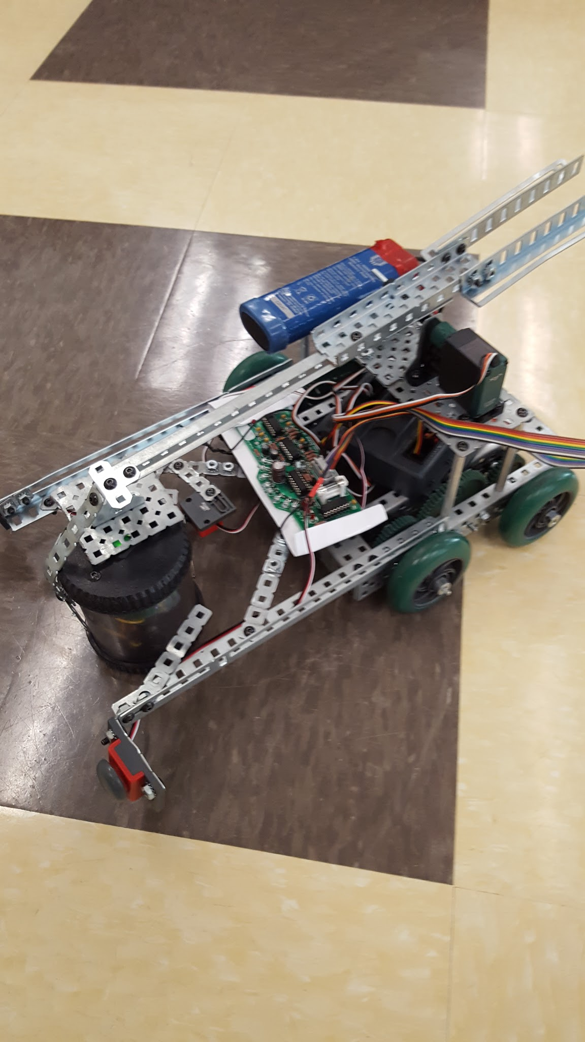
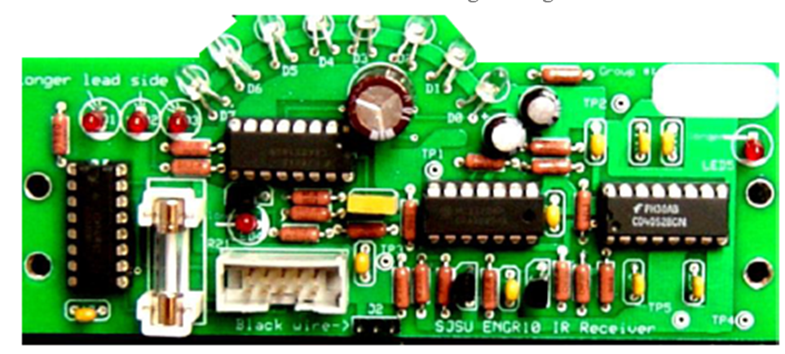
Introduction
Build the Robot
Mechanical Construction
Infrared Receiver Board (IRB) Fabrication
Software Programming.

Slide 3
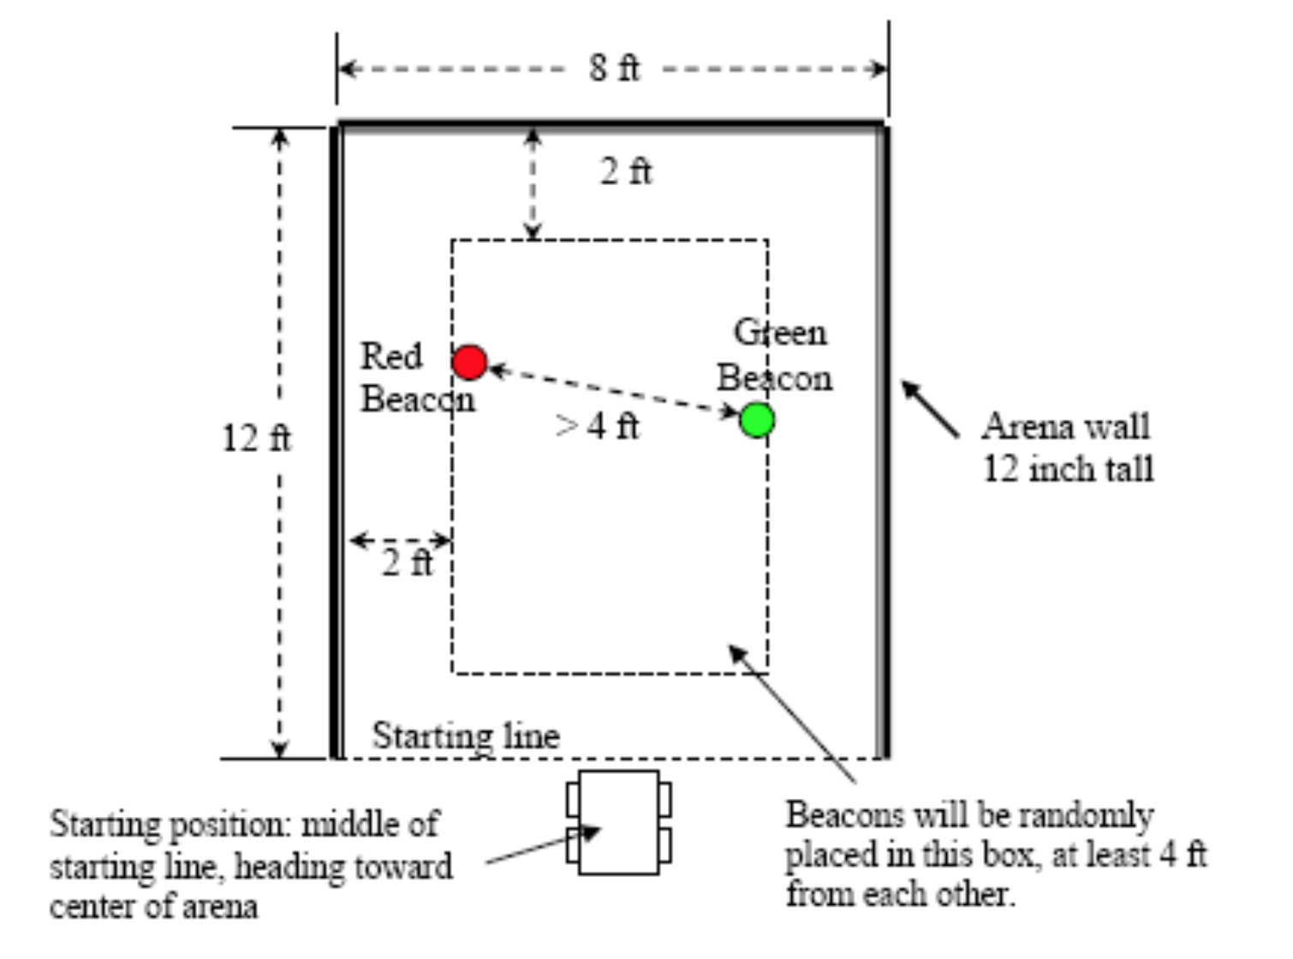
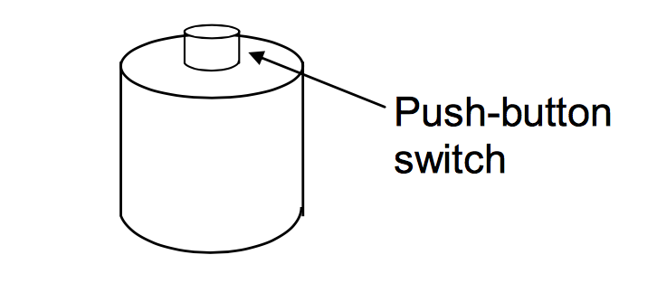
Goal
Shut Down the Red Beacon
Move the Green One Across the Starting Line.

Slide 4
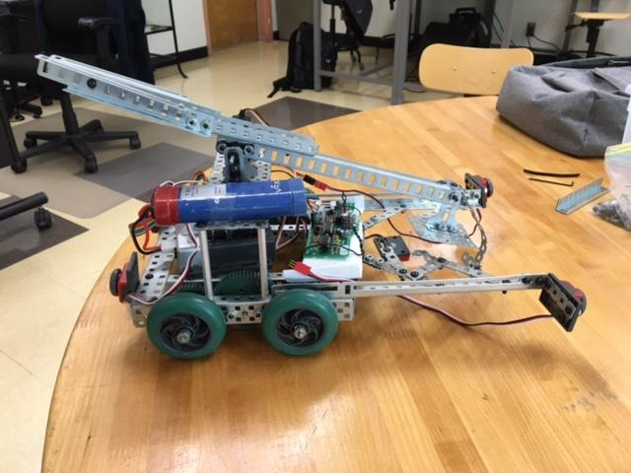
Design
3 motors
Arm with counterweight
2 back buttons
Limit switch in middle
Start button

Slide 5
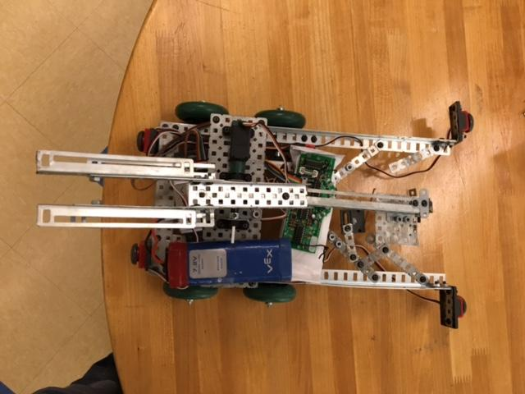
Design
Top

Slide 6
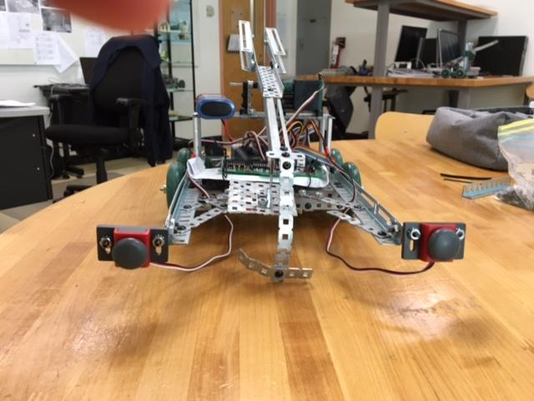
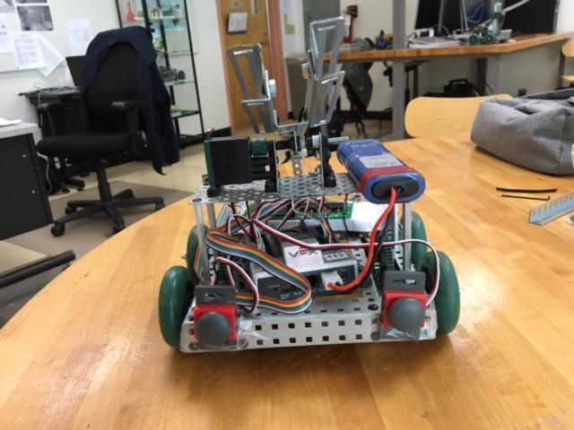
Design
Front
Back

Slide 7
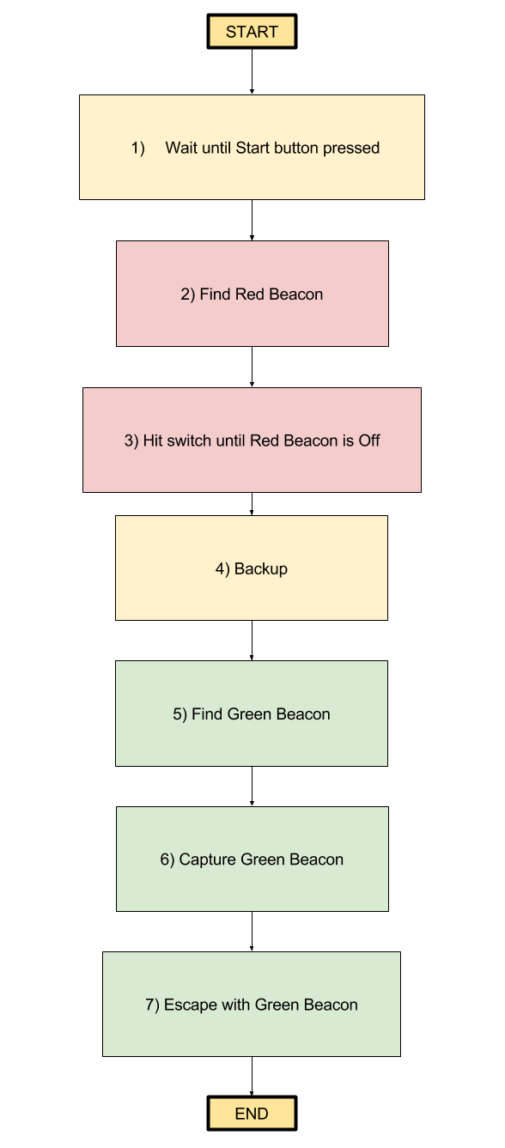
Software

Slide 8
Performance
Turn off Red Beacon: OK
Capture Green Beacon: OK
Take Green Beacon out of arena: OK
Time to complete: 26.11 seconds

Slide 9
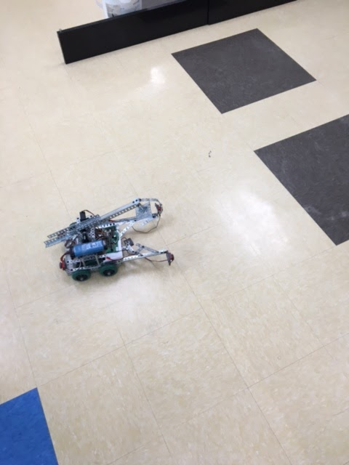
Video

Slide 10
Conclusions
Three Phases:
Mechanical Construction
Infrared Receiver Board (IRB) Fabrication
Software Programming.
Two main goals:
Shut Down the Red Beacon
Move the Green One Across the Starting Line.

Slide 11
Recommendations for Further Work
Building a place for the battery
Making front side of arm lighter

